Slide 1
First 5 Tehama Annual Evaluation Report FY 2020-21
Presented by First 5 Tehama and Applied Survey Research to the
Tehama County Children & Families Commission

Slide 2
State of Children in Tehama County
Tehama County
 |  |  |  | State of
 | 2017 | 2018 | 2019 | California
Children under 5 living in poverty ¹ | 34.3% | 34.5% | 33.6%  | 18.6%
Child abuse allegations (per 1,000) ² | 91.7 | 90.1 | 80.0  | 44.5
Substantiated child abuse/neglect (per 1,000) ³ | 15.0 | 13.6 | 11.0  | 9.9
Children under 5 Attending Well-Child Visit in Last Year (%) ⁴ | 68.9% | 65.9% | 72.6%  | 75.1%
Children under 5 Attending Dental Visit in Last Year (%) ⁵ | 41.1% | 38.7% | 39.1%  | 41.7%
Children Aged 3-4 Enrolled in Preschool (%) ⁶ | 59.2% | 50.4% | 47.9%  | 49.6%
Low SES 3rd Graders Reading At or Above Grade Level (%) ⁷ | 28.1% | 28.1% | 36.3%  | 36.6%
¹ 2017, 2018, 2019 US Census 1-Year Estimates
^{2, 3} 2018, 2019, 2020 UC Berkeley California Child Welfare Indicators Project
⁴ Medi-Cal Managed Care External Quality Review Technical Report
⁵ CHHS Dental Utilization Measures and Sealant Data by County and Age Calendar Year 2013 to 2019 (Medi-Cal)
⁶ 2017, 2018, 2019 US Census, School Enrollment
⁷ California Assessment of Student Performance and Progress – Data Quest
Children under 5 living in poverty has reduced from 34.3% in 2017, to 33.6% in 2019 in Tehama County. This is still higher than the overall rate of children under 5 living in poverty in California (18.6%). Data for 2017, 2018, and 2019 were compiled from US Census 1-Year Estimates.
Child abuse allegations (per 1,000) has reduced from 91.7 per 1,000 in 2018, to 80.0 per 1,000 in 2020 in Tehama County. This is still higher than the overall rate of child abuse allegations in California (44.5 per 1,000). Data for 2018, 2019, and 2020 were compiled from UC Berkeley California Child Welfare Indicators Project.
Substantiated child abuse/neglect (per 1,000) has reduced from 15.0 per 1,000 in 2018, to 11.0 per 1,000 in 2020 in Tehama County. This is slightly higher than the overall rate of child abuse allegations in California (9.9 per 1,000). Data for 2018, 2019, and 2020 were compiled from UC Berkeley California Child Welfare Indicators Project.
Percent of Children under 5 Attending Well-Child Visit in Last Year increased from 68.9% in 2017 to 72.6% in 2019. The rate overall in California is slightly higher (75.1%). Data for 2017, 2018, and 2019 were compiled from Medi-Cal Managed Care External Quality Review Technical Report.
Percent of Children under 5 Attending Dental Visit in Last Year decreased slightly from 41.1% in 2017 to 39.1% in 2019. The rate overall in California is slightly higher (41.7%). Data for 2017, 2018, and 2019 were compiled from CHHS Dental Utilization Measures and Sealant Data by County and Age Calendar Year (Medi-Cal).
Percent of Children Aged 3-4 Enrolled in Preschool decreased slightly from 59.2% in 2017 to 47.9% in 2019. The rate overall in California is slightly higher (49.6%). Data for 2017, 2018, and 2019 were compiled from US Census, School Enrollment.
Low socioeconomic status 3rd Graders Reading At or Above Grade Level increased from 28.1% in 2017 to 36.3% in 2019. The rate overall in California is similar (36.6%). Data for 2017, 2018, and 2019 were compiled from the California Assessment of Student Performance and Progress – Data Quest.

Slide 3
First 5 Tehama Goals
Goal 1 – Improved Family Functioning
Increase family functioning, reduce parental stress, familial poverty, and to increase positive child outcomes.
Goal 2 – Improved Child Health
Ensuring that children are attending regular medical and dental visits and receive preventative care.
Goal 3 — Improved Child Development
Educating and supporting parents on how to increase literacy in the home and by assessing children for developmental delays, so that they can receive early intervention if needed.
Goal 4 — Improved Systems of Care
Increase coordination of different systems, improve collaboration and communication, decrease gaps/duplication in services.

Slide 4
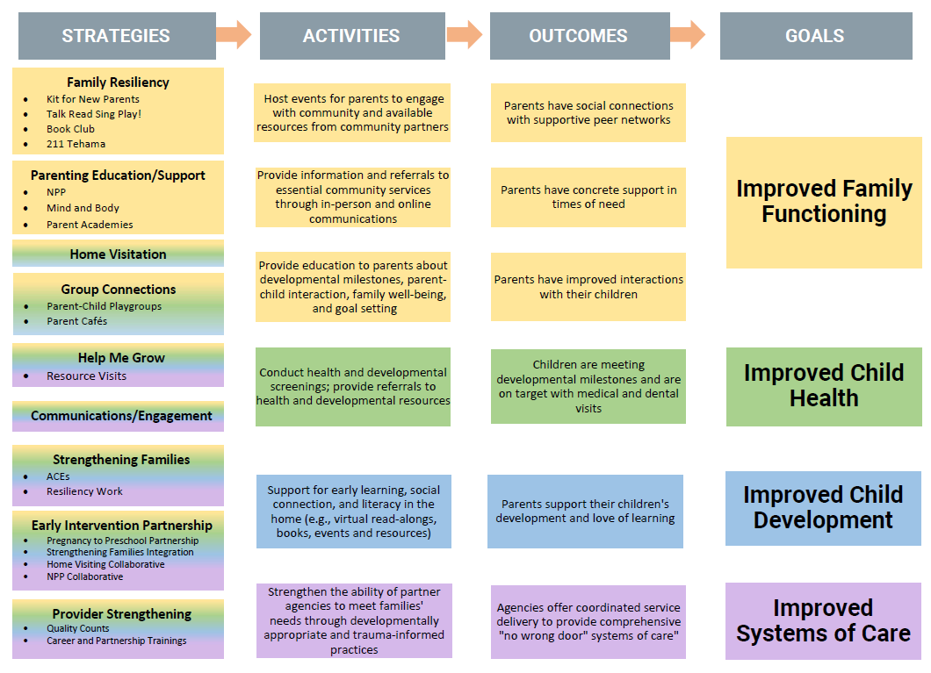
Strategic Framework
The Strategic Framework shows that selected strategies and activities in the areas of family resilience, parenting education, home visitation, group connections, Help Me Grow, communications and engagement, Strengthening Families, Early Intervention Partnership, and Provider Strengthening are expected to produce specific outcomes that relate to our goals to improve family functioning, child health, child development, and the systems of care.

Slide 5
Profile of Children & Caregivers Served
In fiscal year 2018-19 there were 1,240 caregivers and 586 children served. In fiscal year 2019-20 there were 780 caregivers and 502 children served. The dip in people served can be explained, in part, because of the impact of the COVID-19 pandemic. In fiscal year 2020-21 there were more families served with 906 caregivers and 561 children served during the year.
Caregivers
Children

Slide 6
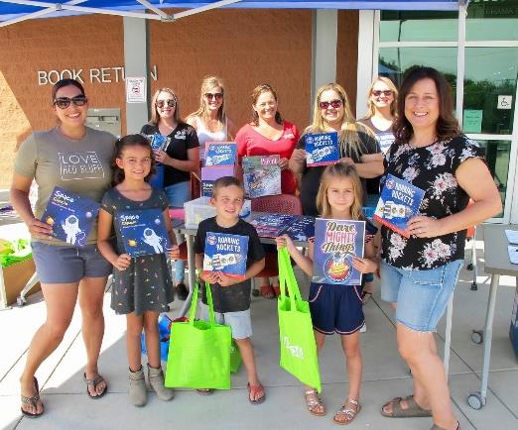
Family Resiliency Initiatives
Book Club
229 children engaged
60% reported reading books with their child five to seven times per week
Kit for New Parents (126 kits)
Talk Read Sing Play! (100 magnets)
2-1-1 Tehama (93 with children 0-5)
Housing, food/meals, utility assistance

Slide 7
Parenting Education/Support Initiatives
Parenting Classes
20 parents attended, 16 completed course
AAPI assessment
52% increase in nurturing skills
32% increase in knowledge of nurturing practices
Parent Academies (66 registered)
Resilience
Early Math
Early Language
Mind and Body Strategies

Slide 8
Parenting/Nurturing Skills
In fiscal year 2020-21, parents who participated in parenting education and support initiatives demonstrated increased parenting and nurturing skills. Among those who complete pre- and post-assessments, 52% more demonstrated use of nurturing skills, 32% more indicated increased knowledge of nurturing practices, 28% more are better able to identify appropriate expectations, 28% more found alternatives to corporal punishment, 25% more indicated a change in values related to power and independence, 23% more show a high level of empathy, and 22% more are better suited to identify appropriate family roles.
Notes:
Numbers/language reported directly from NCCDI

Slide 9
Impact of Parenting Education/Support
“I am so thankful for the teacher who was willing to take the time to let me finish all the classes.
I learned that I was doing the same thing to my son that had been done to me growing up…
and now I can change that”

Slide 10
School Readiness - Home Visiting
Utilizes the Parents As Teachers home visiting curriculum
Recognizes parents as the most influential on their young children
Empowers parents with information about child development and parenting practices
Provides screeners (ASQ/ASQ-SE) that can increase early detection of developmental delays and health issues
Parental education, health and developmental screeners, on-going intensive services

Slide 11
Home Visiting: Parent Child Interactions
Parent-Child Interactions (PICCOLO)
Affection, Responsiveness, Encouragement, and Teaching
Statistically significant improvements overall and in each domain
Largest increase in Teaching domain
Source: School Readiness, Matched Pair N = 30.
Parent-Child Interactions (PICCOLO)
Domains include Affection, Responsiveness, Encouragement, and Teaching
PICCOLO scores were analyzed for 30 matched pre- and post-assessments.
Statistically significant improvements overall and in each domain
Overall PICCOLO score increased from 42.5 to 53.5
Affection increased from 11.6 to 13.4
Responsiveness increased from 9.9 to 12.6
Encouragement increased from 10.5 to 13.0
Teaching increased from 10.5 to 14.5, demonstrating the largest increase in any of the domains.

Slide 12
Impact on Parent-Child Interactions
Generally, the average overall PICCOLO score (at follow-up) increased among participants with more hours of school readiness home visiting
Source: School Readiness, PICCOLO Post-Test and Recorded Number of Home Visits, N = 29
Generally, the average overall PICCOLO score (at follow-up) increased among participants with more hours of school readiness home visiting
For participants with less than 10 visits, the average PICCOLO score was 52.5; those with 10 to 19 visits had an average score of 49.8; those with 20 to 39 visits had an average score of 53.5, and those with 40 or more visits had an average score of 58.

Slide 13
Home Visiting: Child Health
Among home visiting families:
98% of children had medical insurance
74% public insurance (Title XIX/XXI)
93% were current on immunizations
Notes:
Medical insurance: Percentage excludes 28 records with missing data
Immunizations: Children aged 19 months and under three years at any point during the program year, enrolled for at least 90 days

Slide 14
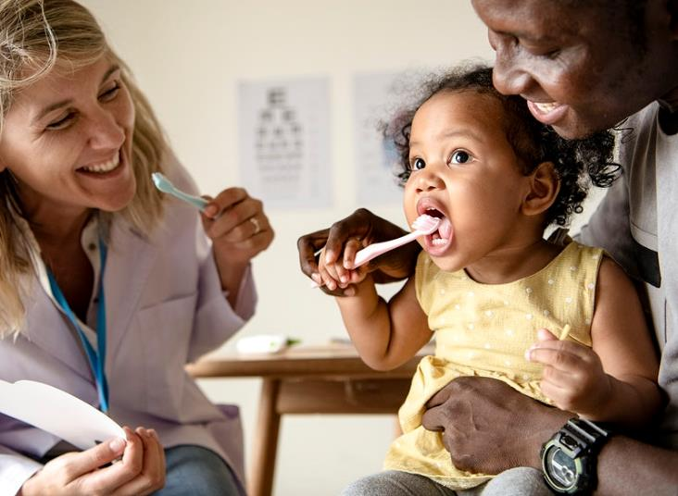
Home Visiting: Child Dental
Among home visiting families:
67% of 3-5-year-old children had first or regular dental appointments
Among home visiting families:
67% of 3-5-year-old children had first or regular dental appointments
This is higher the rate across Tehama County (52%) and California (56%).

Slide 15
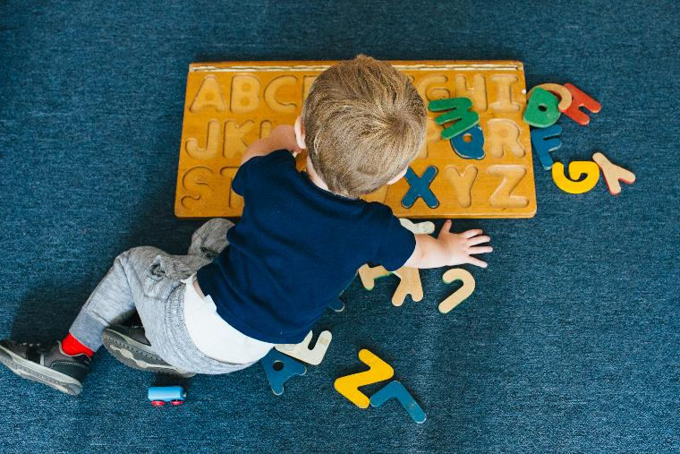
Home Visiting: Child Development
Home Visitors administer Ages & Stages Questionnaire-3 (ASQ) to identify potential problem areas in the following domains:
Communication Skills
Gross Motor Skills
Fine Motor Skills
Problem Solving Skills
Personal-Social Skills
Overall, 79% were meeting all developmental milestones

Slide 16
Screening and Referrals
15 out of 149 (10%) ASQ screenings identified children with developmental concerns
Decreased from 24 (13%) in previous fiscal year
12 received referrals for early intervention services (SELPA)
8 received support services
15 out of 149 (10%) ASQ screenings identified children with developmental concerns
ASQ results are presented in a chart showing the percent of children flagged on the ASQ screening for communication (1%), gross motor skills (3%), fine motor skills (11%), problem-solving skills (6%), personal-social skills (2%).
Decreased from 24 (13%) in previous fiscal year
12 received referrals for early intervention services (SELPA)
8 received support services

Slide 17
Educational Practices and Home Visits
Educational practices increased after home visiting participation
Educational practices increased after home visiting participation
At intake, only 25% of families sang songs to their children compared to 72% at follow-up. 13% of families tell stories to their child at intake, compared to 49% at follow-up. 17% of families read books to their child every day at intake compared to 62% at follow-up. Only 6% visited the library in the 6 months prior to intake compared to 51% at follow-up.

Slide 18
Frequency of Educational Practices
Participants with more home visits reported greater frequency of educational practices
Participants with more home visits reported greater frequency of educational practices
For participants with less than 10 visits, 58% reported singing songs with their children every day, just 56% of those with 10 to 19 visits sang songs every day, compared to 83% of those with 20 to 29 visits, 100% of those with 30 to 39 visits, and 83% with 40 or more visits.
For participants with less than 10 visits, only 25% reported reading or looking at picture books with their children every day, compared to 50% of those with 10 to 19 visits, 85% of those with 20 to 29 visits, 100% of those with 30 to 39 visits, and 83% with 40 or more visits.

Slide 19
Impact of Child Development Activities
“[What I like most is] being able to set goals for my child.
I often think tasks will be too difficult for my child so I don't try…
but my parent educator will incorporate those tasks and
I'm always surprised by my child's abilities.”

Slide 20
Home Visiting: Parent Satisfaction
Overall, home visiting was highly valued among parent participants
57% of parents strongly agreed and 43% agreed (totaling 100%) that home visits helped to increase their understanding of their child's development; 76% strongly agreed and 24% agreed (totaling 100%) that they are satisfied with the program; 89% strongly agreed and 11% agreed (totaling 100%) that they would recommend the program to a friend; 61% strongly agreed and 37% agreed (totaling 98%) that they felt motivated to try new parenting strategies; 33% strongly agreed and 57% agreed (totaling 90%) that they feel better able to handle stress; and 26% strongly agreed and 33% agreed (totaling 59%) that the home visiting program helped them to connect with other families.
83% of parents strongly agreed and 17% agreed (totaling 100%) that their home visitor has their family's best interests in mind; 72% strongly agreed and 28% agreed (totaling 100%) that their home visitor helps them find useful resources; 78% strongly agreed and 20% agreed (totaling 98%) that their home visitor encourages them to read books to their child; 70% strongly agreed and 28% agreed (totaling 98%) that their home visitor helps them work toward their goals; and 74% strongly agreed and 22% agreed (totaling 96%) that their home visitor shares screening results in a way that makes sense.
Notes:
Parents appreciated learning activities and books and saw improvement in their child’s abilities
They were able to connect to other services and learn new ways to help their child learn
Recommendations typically focused on a desire for more in-person visits

Slide 21
Impact of Home Visiting Program
“Este programa a sido de gran utilidad tanto para mi como para mi hija. Para mi fue muy satisfactorio que me pudieron ayudar con inquietudes que yo tenia sobre el habla de mi hija y el desarrolo. Para mi hija fue una alegria de que la educadora le brindo el material necesario para su aprendizaje.”
This program has been very useful for both me and my daughter. For me it was very satisfactory that they were able to help me with concerns that I had about my daughter's speech and development.
For my daughter, it was a joy that the educator provided her with the necessary material for her learning.

Slide 22
Group Connections: Playgroups
Parent-Child Play Groups
Early learning, social development, school readiness, parent tools
39 sessions (52 adults and 66 children)
Two-thirds Hispanic/Latino
Parent Outcomes after Attending Playgroups
76% strongly agreed and 21% agreed (totaling 97%) that they would recommend this Playgroup to a friend; 69% strongly agreed and 28% agreed (totaling 97%) that they learned about other School Readiness activities; 59% strongly agreed and 38% agreed (totaling 97%) that their personal knowledge was respected; 62% strongly agreed and 34% agreed (totaling 96%) that they feel more confident about parenting; 66% strongly agreed and 31% agreed (totaling 97%) that they learned new information about parenting and child development; 48% strongly agreed and 45% agreed (totaling 93%) were comfortable asking questions; 34% strongly agreed and 24% agreed (totaling 58%) that they feel more connected to other parents; 21% strongly agreed and 14% agreed (totaling 35%) that they met someone they plan to stay in touch with.
Notes:
Source: Parents as Teachers database (Penelope). N = 29. Includes percent of participants that agree or strongly agree

Slide 23
Impact of Playgroups
“Playgroups have helped show me that it is okay for the kids to get messy when doing creative activities; they are learning and think this is so much fun!
The kids like interacting with other kids and listening to the home visitors read stories, and loved seeing them when they would drop off their activity.”

Slide 24
Help Me Grow Tehama
Help Me Grow Tehama
Launched online system
Increased outreach to families, companion services, and medical clinics
Embedded into ACEs and P2P focus
Virtual Resource Visits
65 caregivers and 82 children (31 under 3, 51 between 3 and 5)
63% Hispanic/Latino, more than 1/3 primarily spoke Spanish in the home

Slide 25
Communications and Engagement
Email Campaigns (Stories)
4 story-based newsletters to increase community engagement in 0-5
Average of 268 deliveries per story
Open rates exceeded communication industry benchmark (25%) and increased throughout the FY
Click rates were consistent with or exceeded industry averages (2.6%)
Book Club Sign up form had the highest click rate (6.2%)

Slide 26
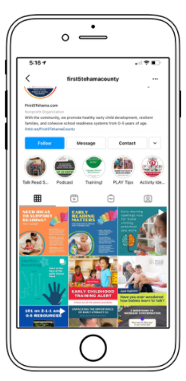
Social Media
Facebook (average monthly reach: 743 users)
Instagram launched (200+ followers in under 6 months)
Innovative reach:
NorCal Champions for Kids Podcast
Family Table Talks YouTube Series
Pinterest Boards
Online read-alongs

Slide 27
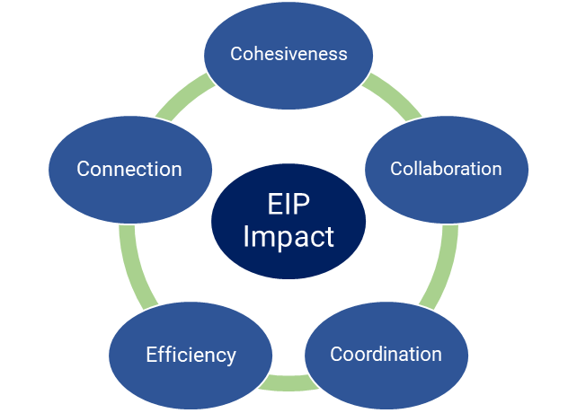
Early Intervention Partnership
Successful Reported Impact
Building better relationships
Increased awareness of other resources
Improving ability to serve families
Increased knowledge to implement effectively (e.g., resiliency, protective factors, ACEs)
Information is shared within the organization, with families, and with external stakeholders/officials

Slide 28
Impact of Early Intervention Partnership
“I believe EIP is essential.… keeping the family and the youth as a priority can make the difference between success [or] failure of a young person’s life” – EIP Member
“Partnering with EIP has provided much insight about resources available with our community. If ever I have a question, EIP tends to have a solution.” – EIP Member
Impact Resource:
Tehama County Environment Scan
Compiled county need through surveys, data, and key informant interviews of 6 home visitors.
“We are valuable because we are there to work with families… to be someone to depend on, to help them as much as we can.”
“We are sometimes their only go-to people.” Tehama County Home Visitors
Impact Resource:
Tehama County Environment Scan
Compiled county need through surveys, data, and key informant
interviews of 6 home visitors.
“We are valuable because we are there to work with families…
to be someone to depend on, to help them as much as we can.”
“We are sometimes their only go-to people.” Tehama County Home Visitors

Slide 29
EIP: Pregnancy to Preschool Partnership
6 partnering organizations
Referral Tracker
75 referrals
51% sent to School Readiness, 25% sent to NCCDI, 21% to State Preschool
10 Referral Trainings to network of care agencies
Referral Tracker Outcomes table shows that 18 out of 75 (24%) were enrolled in services; 15 (20%) were waitlisted in referred service, 35 (47%) were not enrolled, and 7 (9%) no outcome was listed.
Referral Tracker Outcomes | N (%)
Enrolled in services (“Closed Loop”) | 18 (24%)
Waitlisted in referred service | 15 (20%)
Not Enrolled | 35 (47%)
No Outcome Listed | 7 (9%)
Total Referrals on Tracker (FY 2020-21) | 75

Slide 30
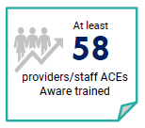
EIP: Resiliency and ACEs
Builds on P2P referral tracker – incorporating co-services
ACEs Aware Grant - 3 convenings of stakeholders
Supported a more integrated system of support
Stronger partnerships and collaboration
At least 58 providers/staff became ACEs Aware trained

Slide 31
Impact of EIP and ACEs
“… an ACEs Aware lens has taught us a new way of seeing our work. … it is not enough to curate and provide resources to those in need. … our network of care can pair ACEs screening with quickly accessible local information and resources.” – ACEs Convening Participant
“We developed a shared language and understanding of how Community and Health Care Integration is already happening in our community and … some of the next steps that we could do to evolve what is already being done.” – ACEs Convening Participant
Notes:
NOTE THIS IS aCTUALLY 56 not 52.

Slide 32
Additional Systems Work
Home Visiting Collaborative
Increased social-emotional and resilience trainings
56 providers registered for early educator trainings
Spanish Language Only Mind and Body Training Exclusively for Home Visitors
Nurturing Parenting Program Collaborative
Focus on best practices
Provider Strengthening: Quality Counts North State
49 Tehama providers engaged
First 5 Tehama donated $500 to efforts
Career and Partnership Trainings
183 participants registered
Home Visiting Collaborative
Increased social-emotional and resilience trainings
56 providers registered for early educator trainings
Nurturing Parenting Program Collaborative
Focus on best practices
Provider Strengthening: Quality Counts North State
49 Tehama providers engaged
First 5 Tehama donated $500 to efforts
Career and Partnership Trainings
183 participants registered
Spanish Language Only Mind and Body Training Exclusively for Home Visitors

Slide 33
Home Visiting Collaborative Impact
“The training was amazing, I had a moment-we all had our moments and needed them to cry. This was the first time we have ever got to learn in Spanish and it felt like it was just for us. We always are focused on giving information to our families but this was different and we all had things we needed to share out loud or with each other. This is my family so its like we got the home visiting together. I would do it again tomorrow.”

Slide 34
Successes and Future Goals
Innovative engagement in light of COVID-19
Modeling HMG to navigate gaps
Providing hybrid services
Using data to model communication and training
New Initiatives:
Book Club
ACEs Aware work, trauma-informed care
Media/Communications expansion
New trainings and workshops for professionals
FY 2021-22:
Utilizing data and discussions to develop Strategic Plan
Continue expanding developmentally appropriate and trauma informed care for network of care
Strengthen capacity to provide 0-5 early education backbone infrastructure

